Slide 1
RECOMMENDED TOUR
CRE DIRECTORS

Slide 2
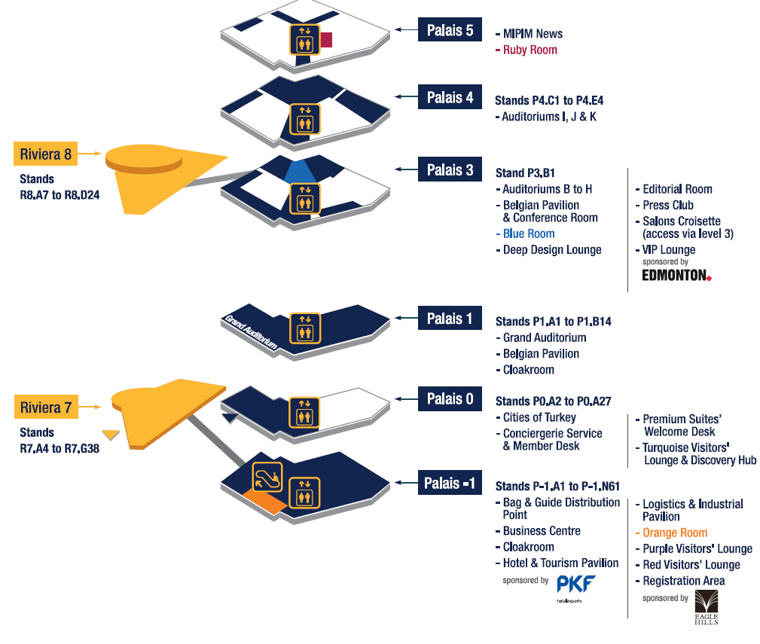
PALAIS DES FESTIVALS

Slide 3
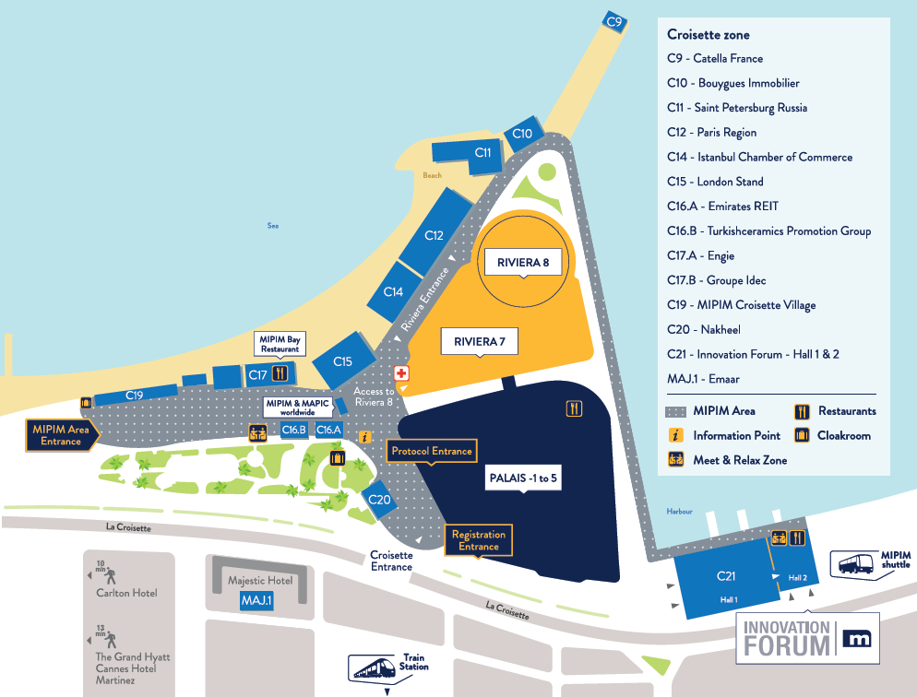
TENTS AND OUTSIDE PAVILLIONS
Saint Petersburg Russia – stand C11
Saint Petersburg is one of the most actively regions in Russia. It has a great investment potential. The main advantages of Saint Petersburg are its profitable geopolitical position, its developed and diversified aconomy, and its efficient transportation network. These are valuable resources fop making the innovations and industry development.
Paris Region – stand C12
Projects showcase by many partners: EPADESA, Société du Grand Paris, Plaine de France, Paris Saclay, Sénart, …
Nakheel – stand C20
Nakheel is one of the world’s leading developers and a major contributor to realising the vision of Dubai for the 21st century: creating a world class destination for living, business and tourism. Nakheel continues to deliver and enhance an iconic portfolio of innovative projects in Dubai across the residential, retail, hospitality and leisure sectors
Mipim Innovation Forum – stand C21
A 1,300 m² pavilion gathering all innovation stakeholders to showcase the most innovative solutions and practices to increase the value of property assets.

Slide 4
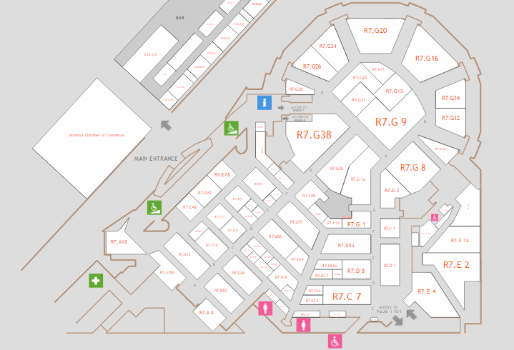
RIVIERA HALL 7
City of Munich – stand R7-G16
A balanced mix of industries from international high-tech players to small skilled crafted firms combine with powerful innovative capabilities and an excellent business climate to safeguard the economic future of this exciting city.
Marseille – stand R7-E57
Projects showcase by many partners: Port of Marseille Fos, Aix Marseille Metropole, Euromediterrannée, …
Grand Lyon– stand R7.E4
Greater Lyon and its partners have come together under the ONLYLYON banner to introduce you to the vibrant property market of the Lyon urban area with projects in the spotlights: Lyon Part-Dieu, Lyon Confluence, Lyon Carré de Soie and Lyon Gerland.

Slide 5
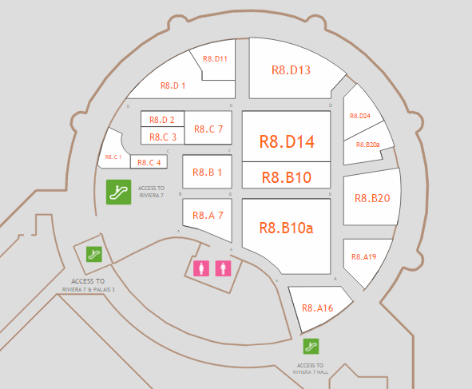
RIVIERA HALL 8
City of Warsaw– stand R8-D1
Numerous projects such as: Metro Warsaw, Gdanski Business Center, West Station, Zlota 44, Business Garden Warszawa, …
ICE – Italian Trade Agency – stand R8-B10/B10a
Projects showcase by many partners: Port of Marseilel Fos, Aix Marseille Metropole, Euromediterrannée, …
CAME– stand R8.A16
CAME is leader in automation systems for residential and industrial entrances, parking lots, access control and queue management.

Slide 6
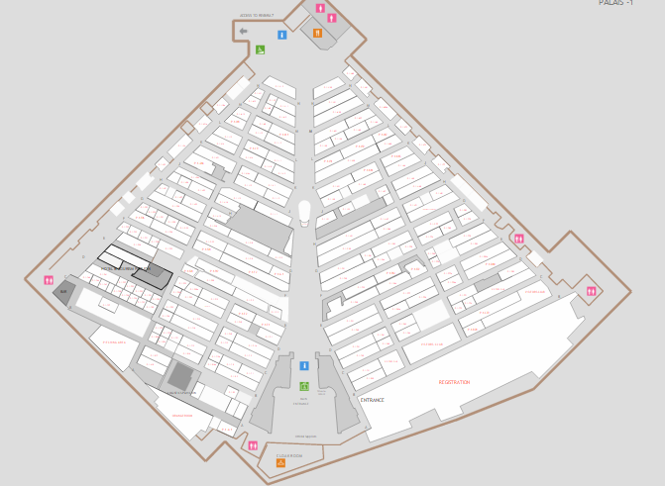
PALAIS-1
City of Malmö – stand P-1.L9/P-1.K21
Malmö Trade & Industry Agency is the City of Malmö’s department that provides practical support to companies considering to establish, expand or relocate their Business in the Malmö area.
.
Barcelona CATALONIA– stand P-1.K50
Barcelona-Catalonia is the commitment of the Government of Catalonia – through Incasol – and the Barcelona City Council to promote strategic new projects for a new city model closely linked to the knowledge economy, and to position Barcelona and Catalonia as hubs of innovation, in surroundings with powerful knowledge-intensive and mobility infrstuctures.
Ministry of Tourism of Brazil– stand P-1.H81
Toursim projects in Brazil and investment opportunities.

Slide 7
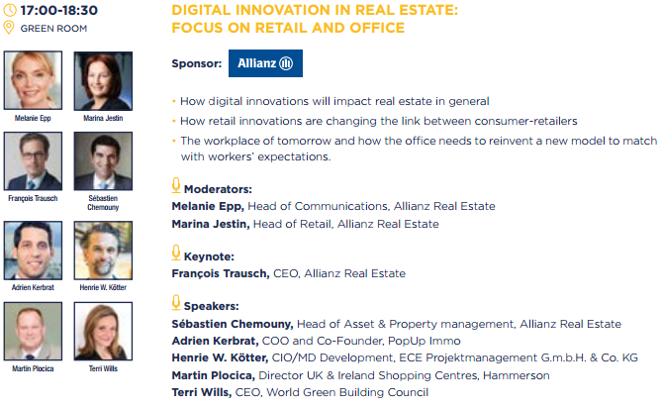
RECOMMENDED CONFERENCES & EVENTS

Slide 8

RECOMMENDED CONFERENCES & EVENTS

Slide 9
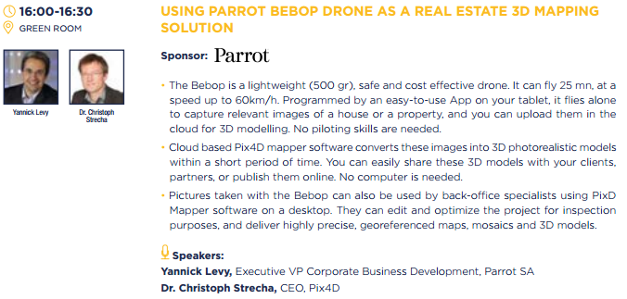
RECOMMENDED CONFERENCES & EVENTS

Slide 10
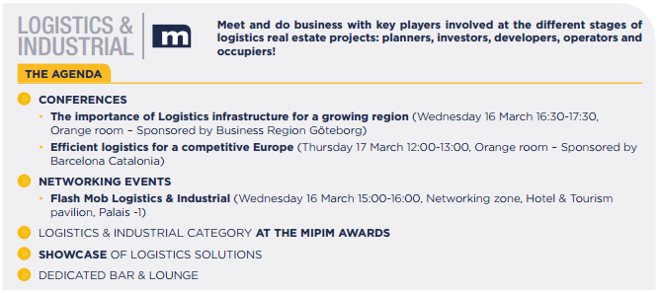
RECOMMENDED CONFERENCES & EVENTS

